Slide 1
Power Point for Middle Level Students
Created by Gurinder Cheema
Education Specialist, BC Agriculture in the Classroom Foundation

Slide 2
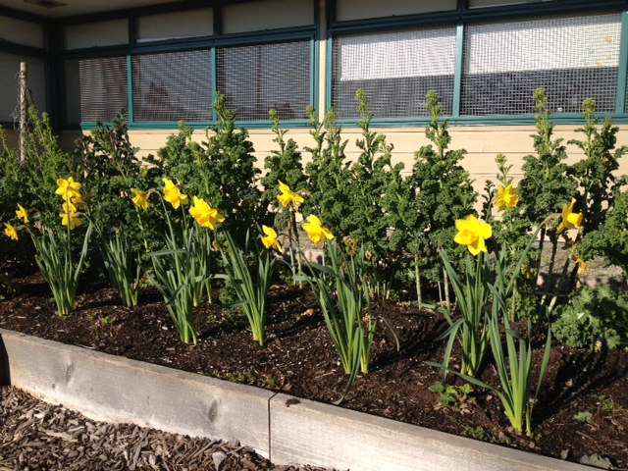
This presentation will explain:
What plants need to Grow
Life Cycle of a Daffodil
Parts of the Daffodil
? When you see this RED question mark,
Raise your hand if you know the answers!

Slide 3
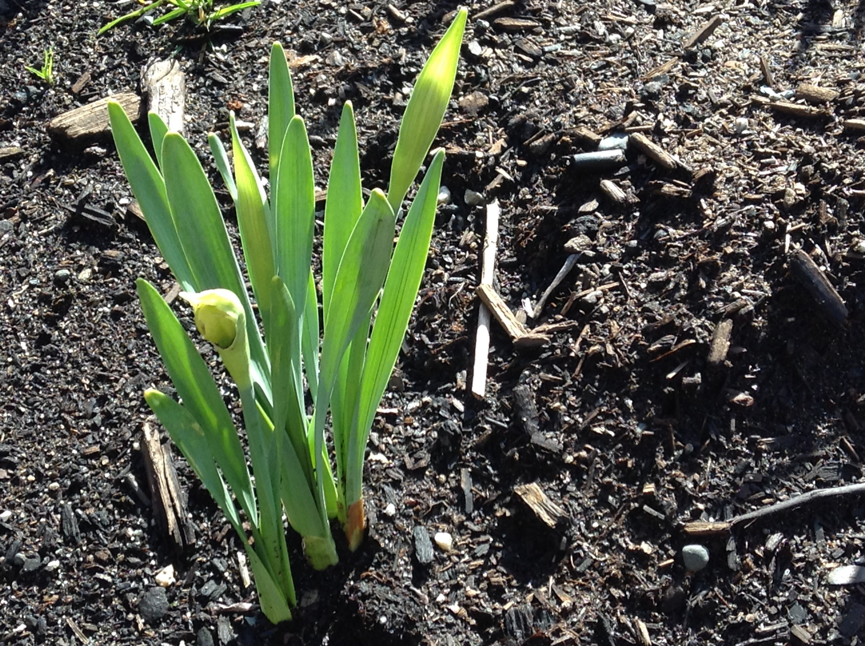
?What do HUMANS need to Live and Grow?
Water
Food
Air and Space

Slide 4
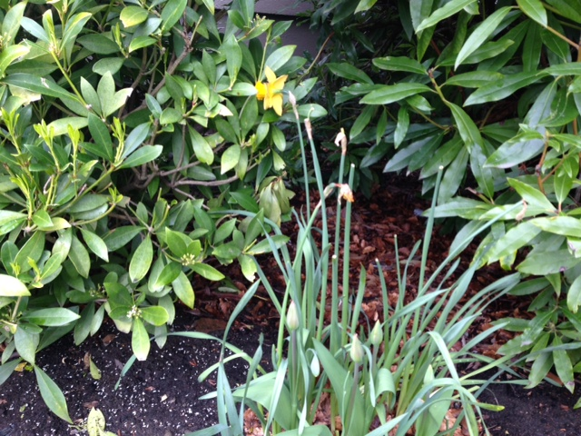
? What do PLANTS need to Live and Grow?
Water
Food: Soil and nutrients
Air and space
Sun (light energy)

Slide 5
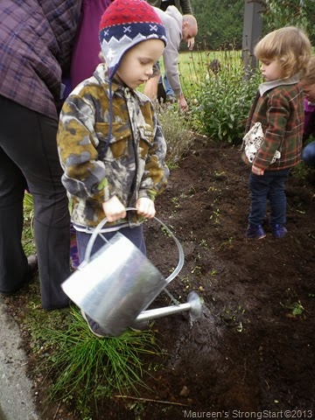
WATER
essential for all life on earth
Root hairs absorb water from the soil, then stems carry it to the rest of the plant

Slide 6
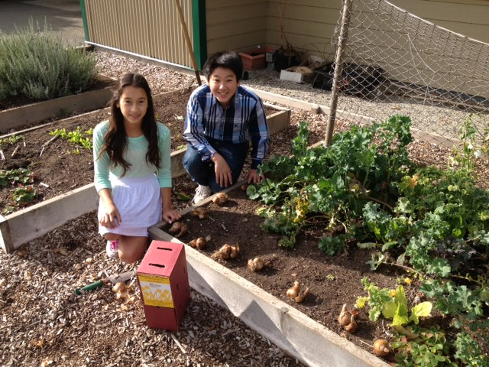
SOIL:
Soil provides water and nutrients for plant growth
Soil provides support for the plant and an anchor for the roots
Decaying plants provide nourishment to the soil (good 4 future plant growth)

Slide 7
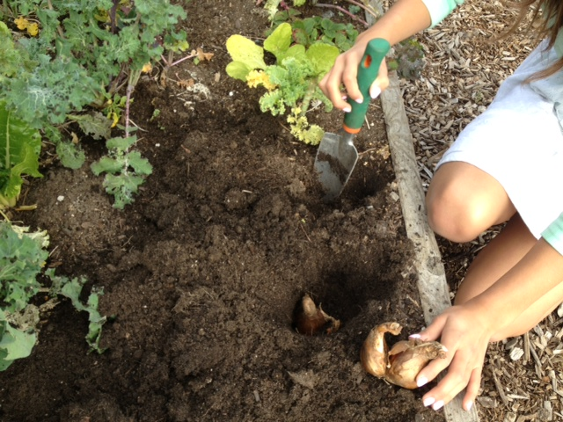
More on SOIL:
Soil is important to farmers; without it they cannot grow food for you to eat!
Our farmers protect our soils from erosion and degradation.
? Who/what else depends on soil to live?
Insects and small mammals

Slide 8
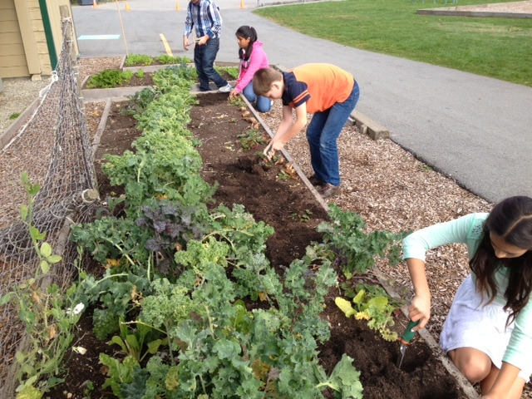
Air (and space)
Plants can’t grow too close together or their roots and leaves will compete for the limited resources (water and nutrients) they all need
?What would happen if there was no air?
We need oxygen to keep our bodies working
Try holding your breath…

Slide 9
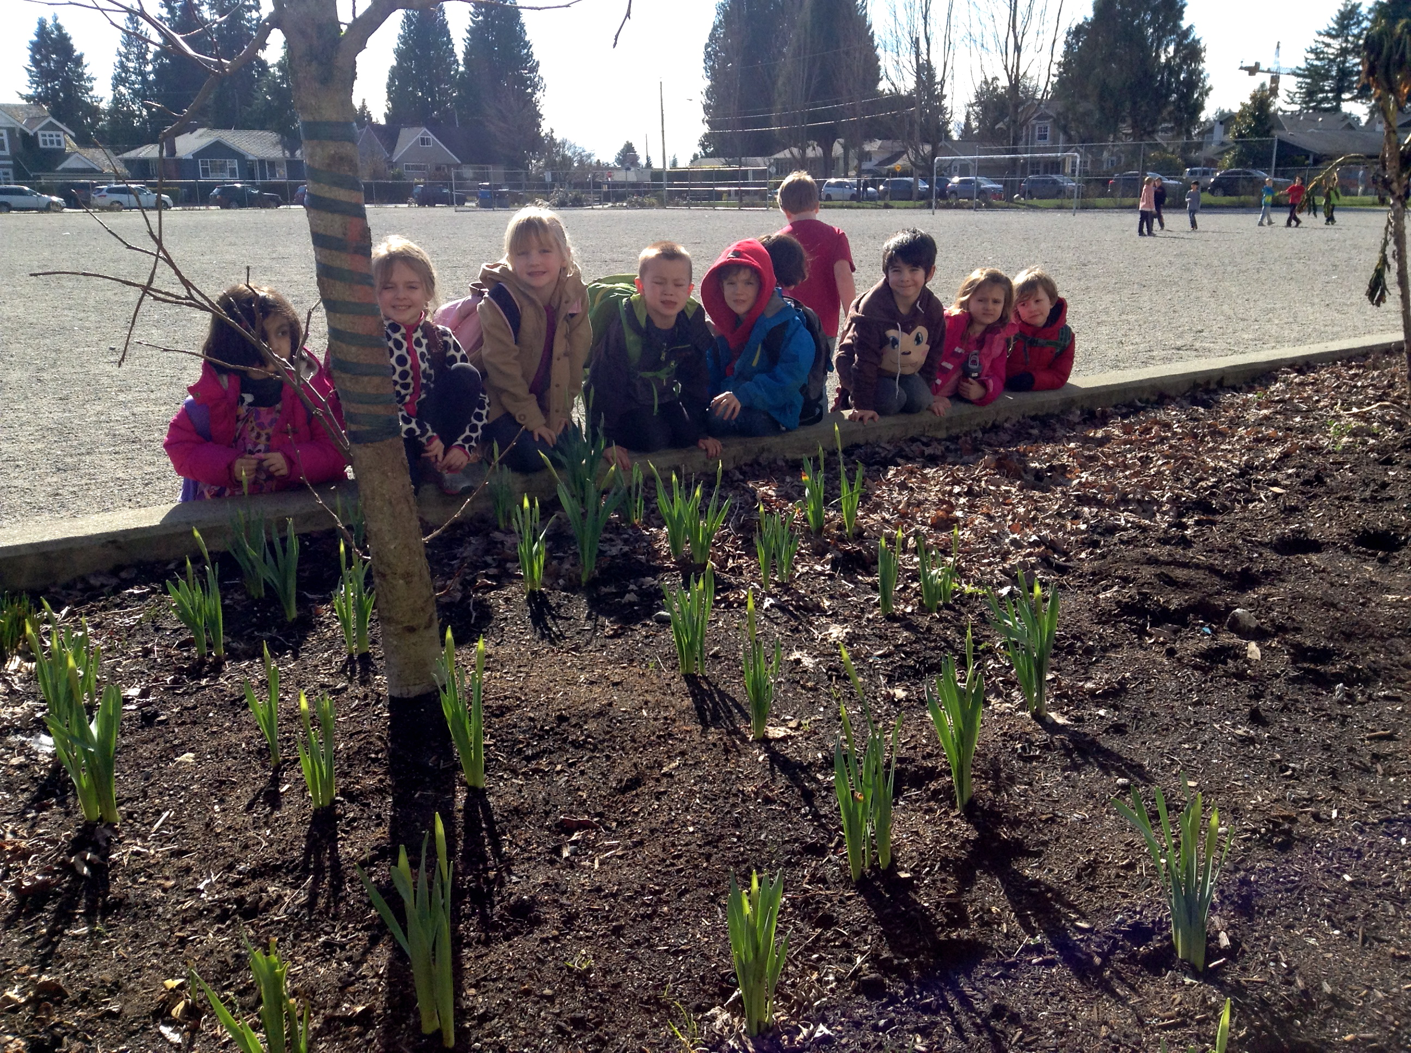
Sun (light)
Plants use light energy from the sun to change carbon dioxide (CO₂) from the air and water (H₂O) from the soil into food substances (sugars and starches).
? What is this process called?
photosynthesis

Slide 10
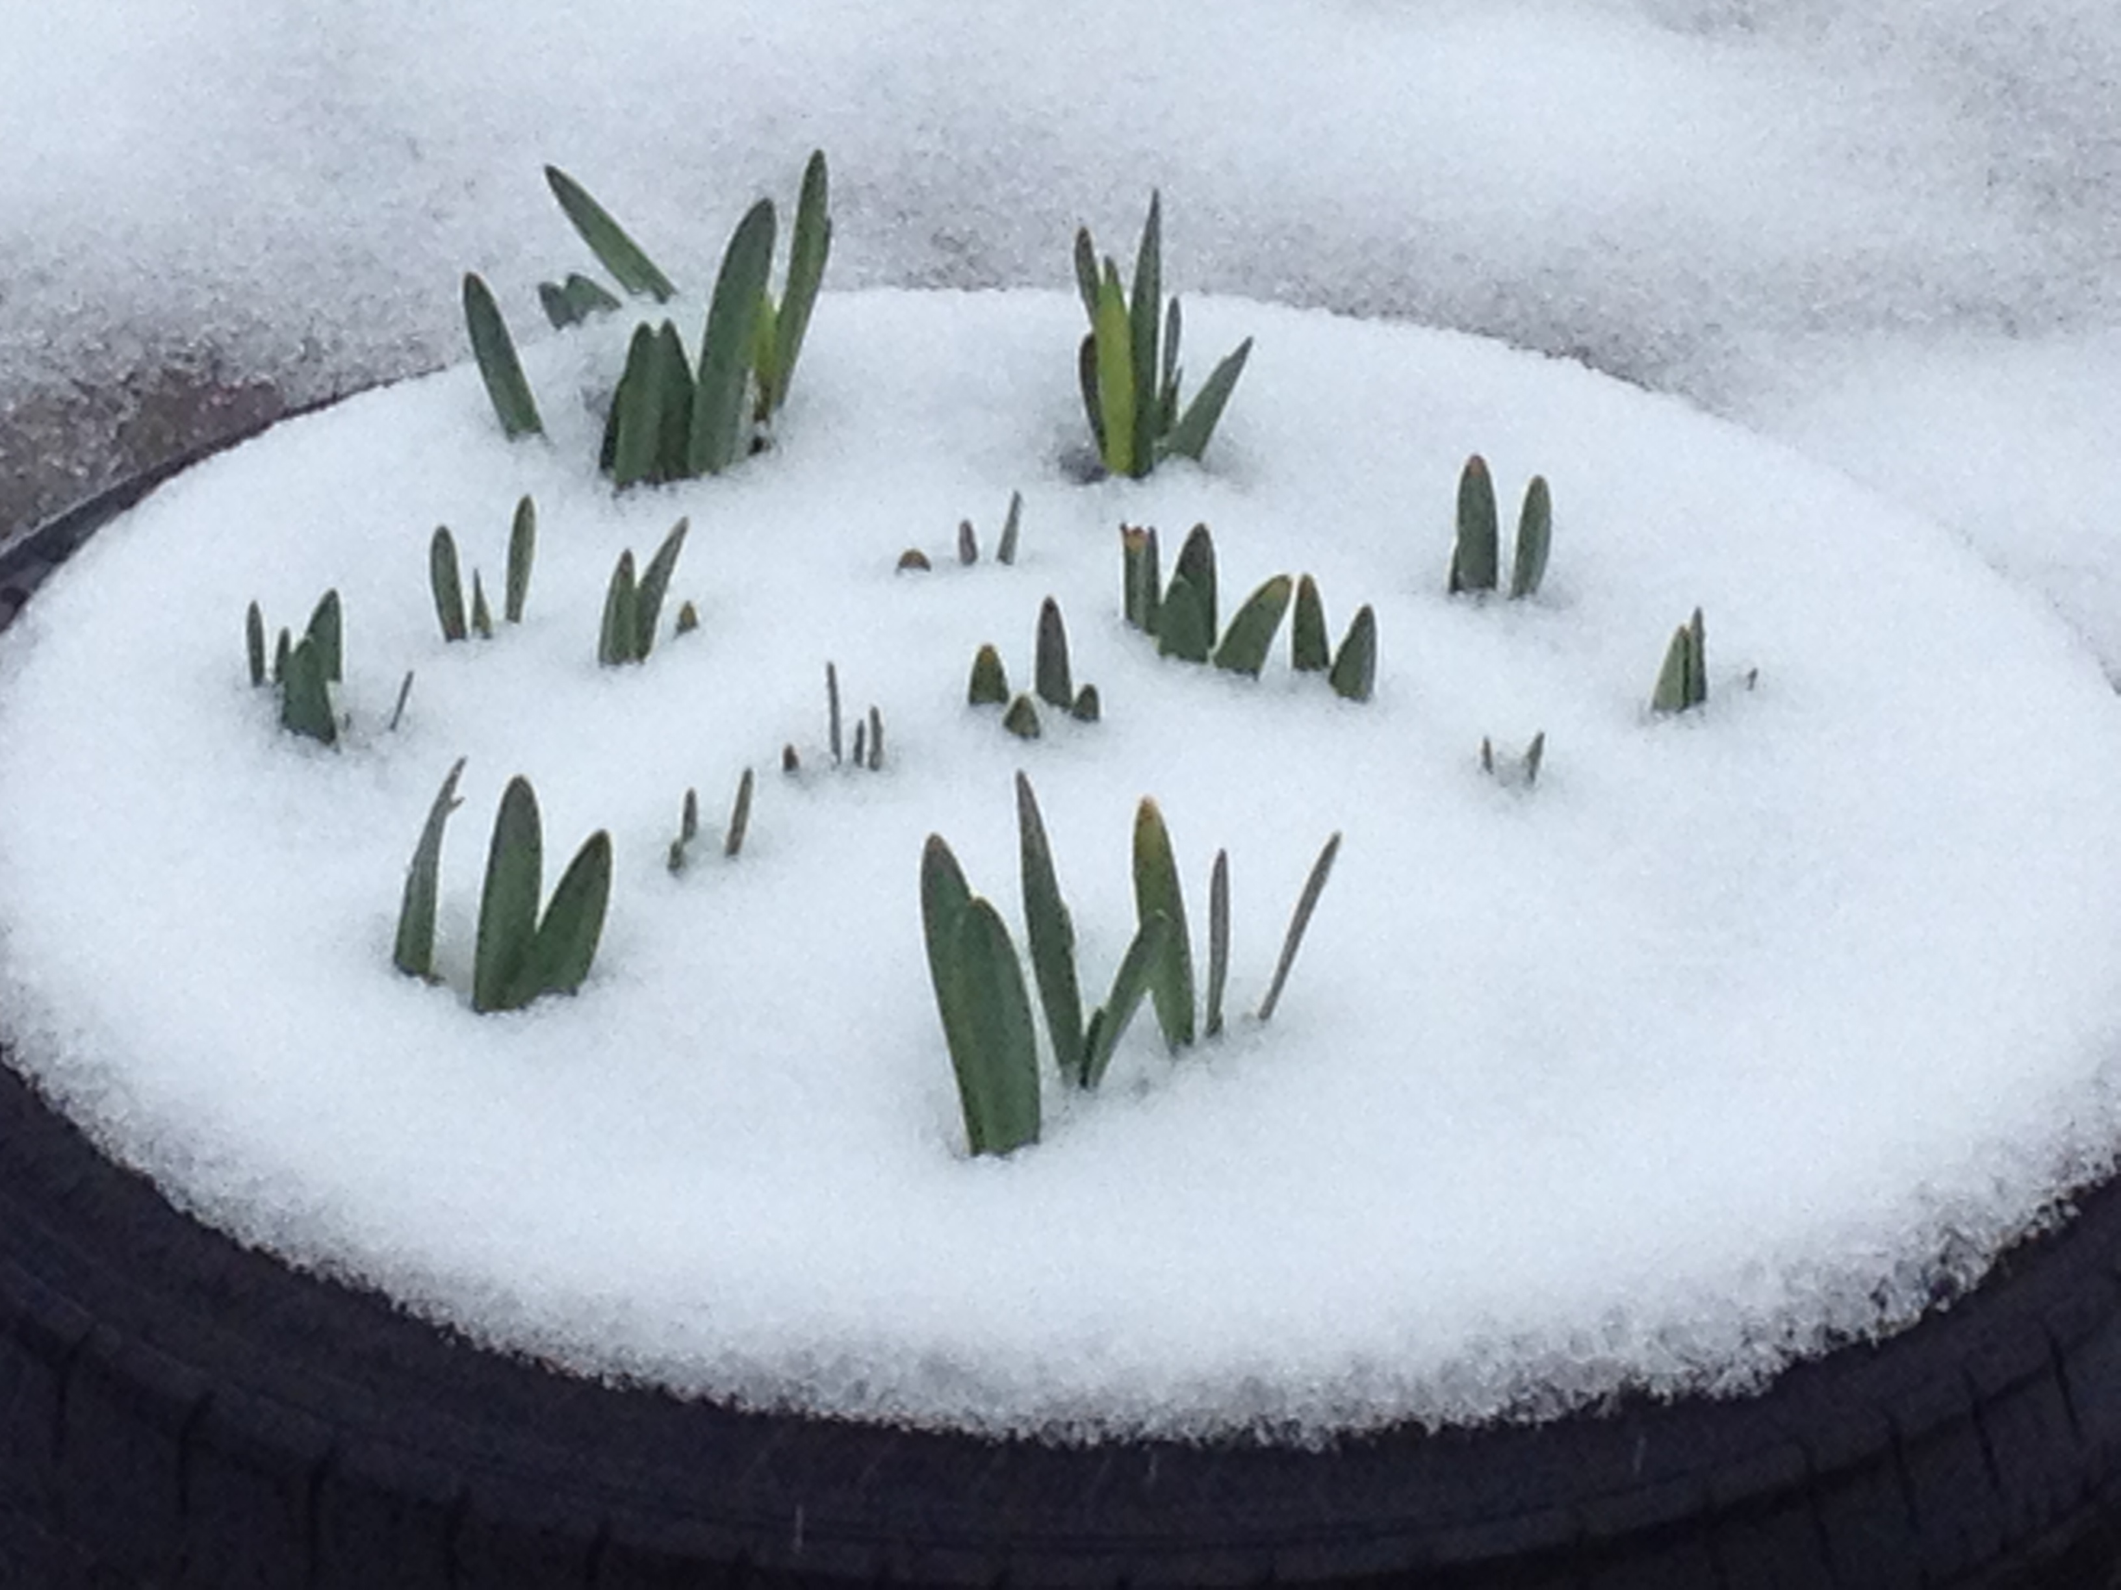
Life Cycle of a Daffodil
FALL
Life starts
Roots begin to grow as soon as bulb is planted (underground until spring)
SPRING
Flower blooms (mid-April to May)
SUMMER
Plants go to sleep by August

Slide 11
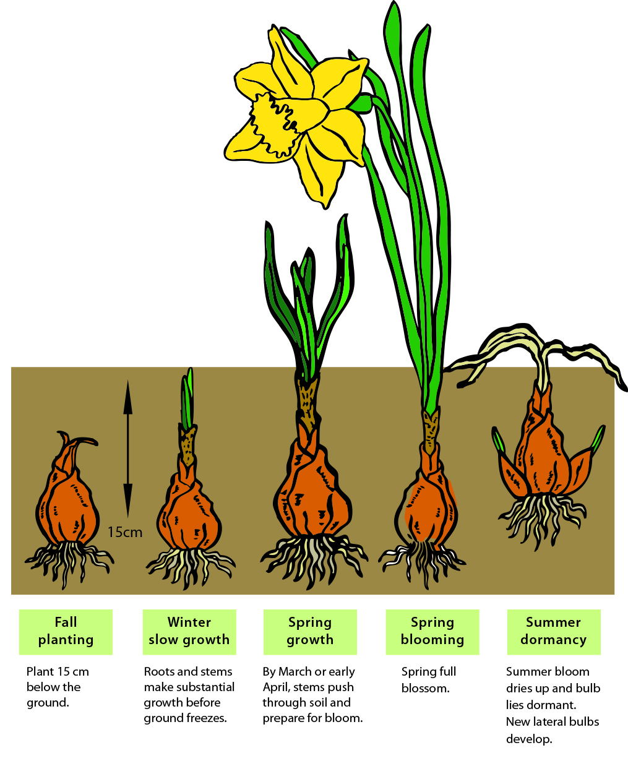
Life Cycle of a Daffodil

Slide 12
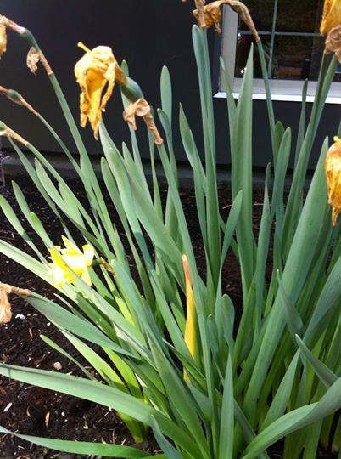
Dormancy: living but not actively growing
Daffodils enter their dormant stage in late June (and stay dormant all Summer)
When the soil temperature is cool enough (Fall) and there is enough water it signals the plant inside the bulb to grow again and bloom (Spring)

Slide 13
? What Colours are Daffodils?
yellow-and-white, yellow-and-orange, white-and-orange, pink, and lime-green

Slide 14
? How tall can they get?
Up to 60 cm! (approx.24 inches)

Slide 15
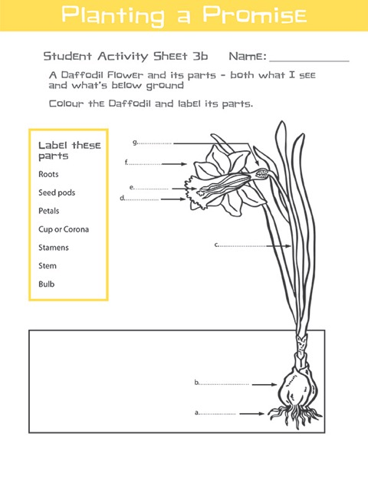

Slide 16
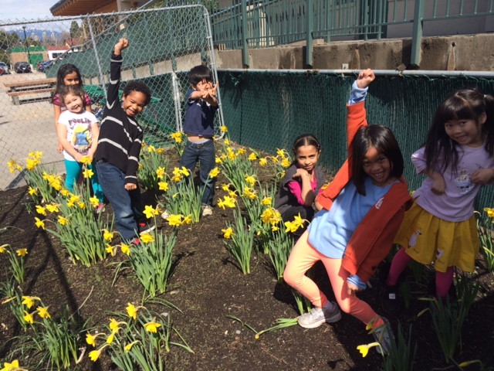
? How EXCITED are you going to be in Spring when you see your daffodils?

