Slide 1
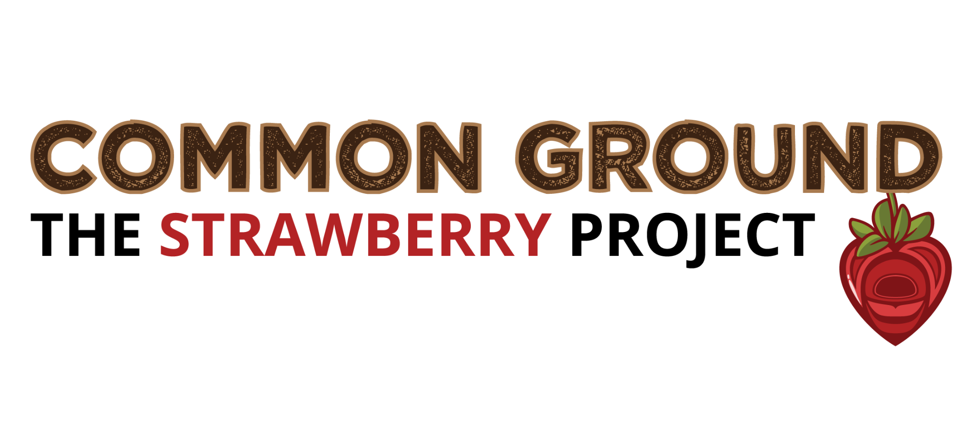
Let's play!

Slide 2
A Race Around the Strawberry Patch
Instructions:
1. The goal of the game is to be the first player to reach the finish line.
2. To begin, each player begins on the Start square. Player 1 rolls the dice to indicate how many spaces they can move.
For example, if Player 1 rolls a two, and they answer correctly, their pawn moves forward two spaces on the board. If they answer incorrectly, their pawn remains stationary and the play moves to the player on the left.
3. The first player to land at the finish line wins the game.

Slide 3
A Race Around the Strawberry Patch
Frequently Asked Questions:
1. How do the dice work?
To operate, click on the dice on the game board and it will open a separate window. Be sure to select the number of dice sides to 3 before rolling the dice.
2. Can this template be used with multiple platforms?
Yes, this template can be used with Google Slides, Keynote and PowerPoint.
3. Why can’t I move the digital pawns on the board?
To see and move the pawns, this template must be used in Edit mode in Google Slides and PowerPoint.

Slide 4
Question 1
Strawberry plants are considered “perennial”. What does this mean?
Backside

Slide 5
Question 2
Check out the video! How many seeds can one strawberry contain?
Backside

Slide 6
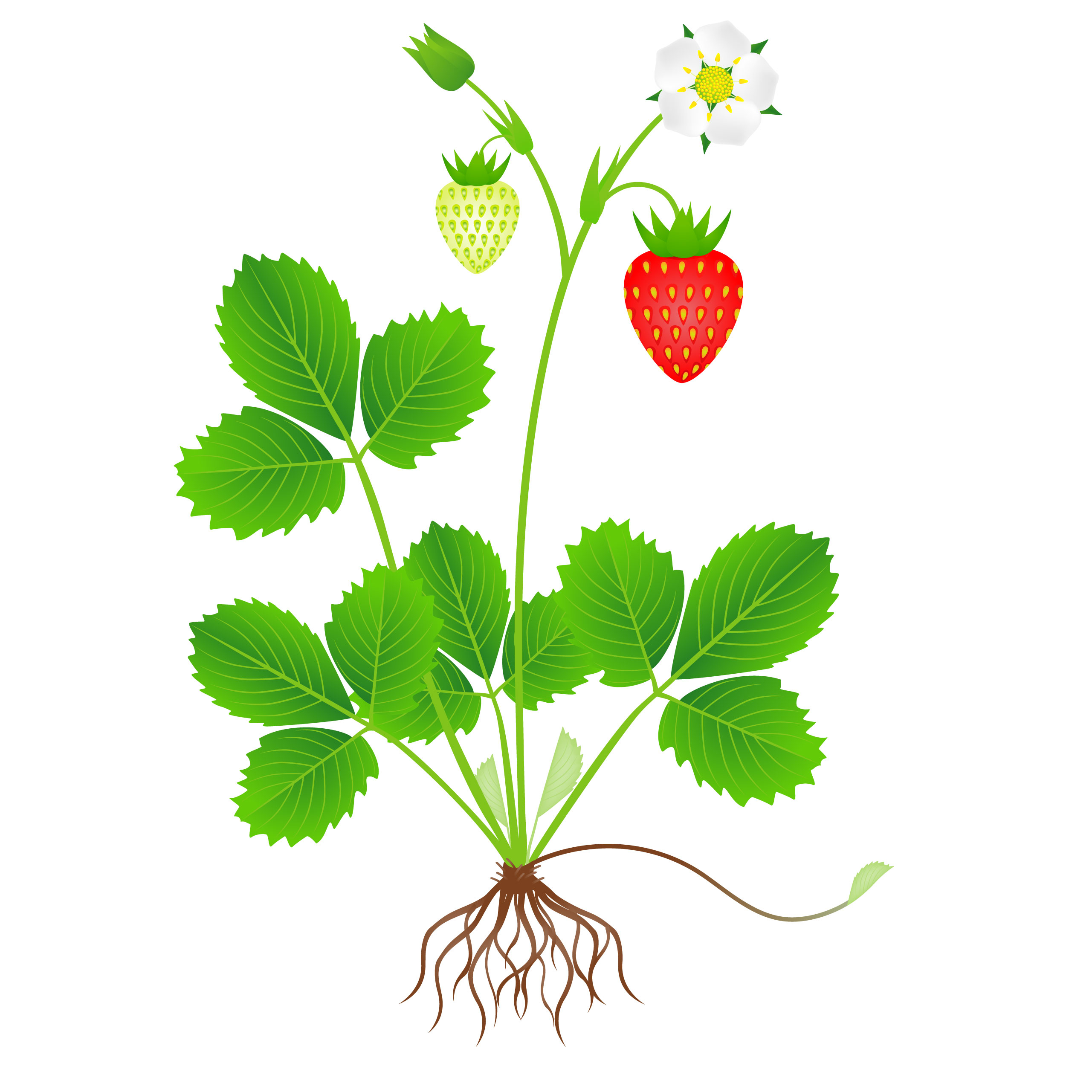
Question 3
Name the part of the plant. You can click on it to enlarge it.
Backside

Slide 7
Question 4
Can you guess the insect that makes this sound? Hint: It pollinates strawberry plants.
Backside

Slide 8
Question 5
Free
Pass!
Backside

Slide 9
Question 6
What do strawberries need in order to grow strong and healthy?
Backside

Slide 10
Question 7
Why are strawberries not considered “true berries?”
Backside

Slide 11
Question 8
How are cultivated strawberries different from wild strawberries?
Backside

Slide 12
Question 9
What is a strawberry crown?
Backside

Slide 13
Question 10
Strawberries were used by the Indigenous people in BC for medicine. What were they used to help treat?
Backside

Slide 14
Question 11
Which family of plants do strawberries belong to?
Backside

Slide 15
Question 12
In which part of the strawberry plant does photosynthesis occur?
Backside

Slide 16
Question 13
How are strawberries harvested?
Backside

Slide 17
Question 14
What are the new shoots that come from the mother plant called?
Backside

Slide 18
Question 15
What is the difference between a june-bearing and an everbearing variety of strawberry?
Backside

Slide 19
Question 16
What is the most popular flavour of yogurt in North America?
Backside

Slide 20
Question 17
Strawberry plants can be pollinated by wind, insects and spiders. What is pollination?
Backside

Slide 21
Question 18
Name three foods you can make with strawberries?
Backside

Slide 22
Question 19
Strawberries are very nutritious. Name at least one vitamin that is found in high amounts in strawberries.
Backside

Slide 23
Question 20
In many Indigenous cultures, the wild strawberry is known by another name because of its shape. What is it called?
Backside

Slide 24
Question 21
What is a seedling?
Backside

Slide 25
Yayyy!
You did it!

Slide 27
Answer for Question 1
Perennials are plants which are expected to live longer than two years. They're able to live for so long because they can stay dormant during the winter.

Slide 28
Answer for Question 2
Strawberries contain anywhere from 150-200 seeds in a single fruit.

Slide 29
Answer for Question 3
This is called the root.
The strawberry roots grow downward holding the plant securely in the soil while absorbing water and nutrients.

Slide 30
Answer for Question 4
The sound is a bee.
Bees are excellent pollinators! They spend most of their lives collecting pollen. Pollination is needed for plants to reproduce, and so many plants depend on bees or other insects as pollinators.

Slide 31
Answer for Question 5
Free
Pass!

Slide 32
Answer for Question 6
Strawberries need sunlight, water and nutrients to grow.

Slide 33
Answer for Question 7
Berries have seeds on the inside of the fruit, so strawberries are not considered a “true berry” because their seeds are on the outside.

Slide 34
Answer for Question 8
Wild strawberries are typically smaller and often sweeter than cultivated berries grown on farms.

Slide 35
Answer for Question 9
The crown is the part of the plant just above the hairy roots, but below the green shoots.

Slide 36
Answer for Question 10
Indigenous people of BC made tea from dried strawberries to treat sore throats.

Slide 37
Answer for Question 11
Strawberries belong to the rose family of plants.

Slide 38
Answer for Question 12
Photosynthesis mostly occurs in the leaves.
Strawberry plants use carbon dioxide, water and sunlight during photosynthesis and convert these into oxygen and food for the plant.

Slide 39
Answer for Question 13
Strawberries are delicate fruits and are harvested by hand.
Morning, when the berries are still cool, is the best time for picking strawberry fruit.

Slide 40
Answer for Question 14
These are called the runners.

Slide 41
Answer for Question 15
June-bearing strawberry plants, produce a big crop of large berries in the month of June. Everbearing bushes, usually have smaller berries and have 2-3 crops in a season

Slide 42
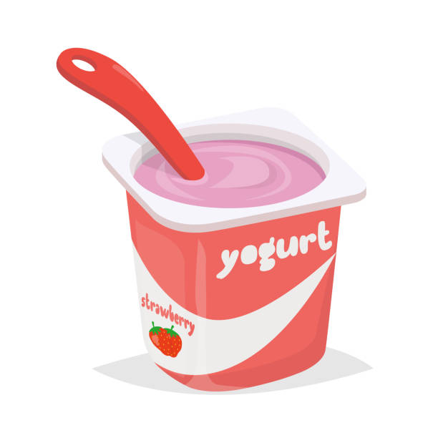
Answer for Question 16
Strawberry!

Slide 43
Answer for Question 17
Pollination occurs when pollen is moved from male plant parts to female plant parts by pollinators like insects.
Pollination is needed to produce fruit and seeds.

Slide 44
Answer for Question 18
Answers will vary.

Slide 45
Answer for Question 19
Strawberries are an excellent source of Vitamins C and K.

Slide 46
Answer for Question 20
It is called the “heart berry.”
Despite its small stature, strawberry plants carry big, powerful teachings representing peace and forgiveness.

Slide 47
Answer for Question 21
A seedling is a small plant that is grown from a seed.

