Slide 1
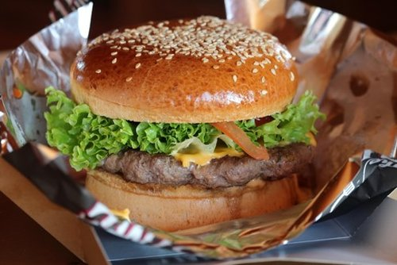
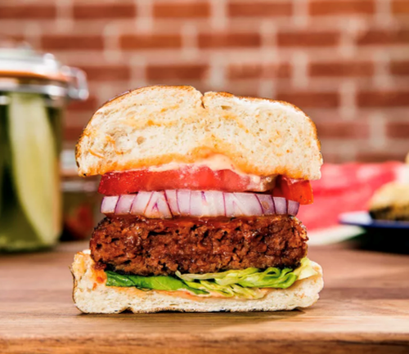
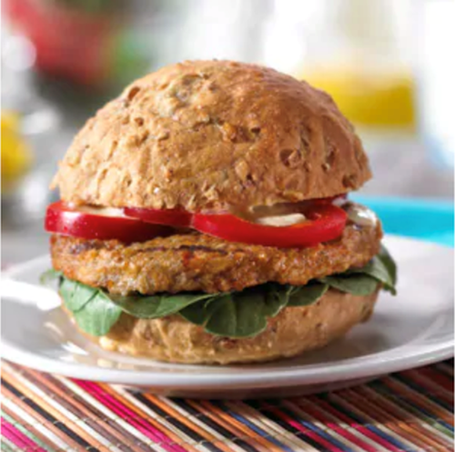
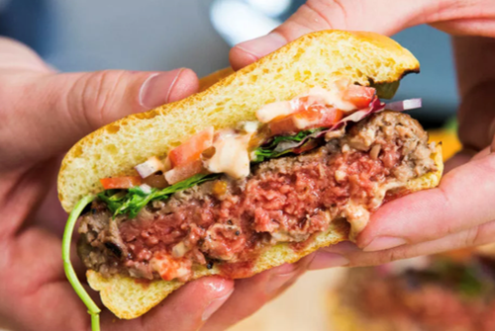
Meat or Meatless?
1
2
3
4
MorningStar Farms Garden Veggie Burger (plant-based)
Impossible Foods Burger (plant-based)
Beyond Meat Burger (plant-based)
80-85% Lean Beef Burger (beef)
Notes:
1- 80-85% lean beef burger
2- The Beyond Meat Burger
3- MorningStar Farms Garden Veggie Burger
4- The Impossible Burger

Slide 2
Meat or Meatless?
80-85% Lean Beef Burger (beef)
1
Beyond Meat Burger
(plant-based)
2
MorningStar Farms Garden Veggie Burger (plant-based)
Impossible Foods Burger
(plant-based)
3
4
Notes:
1- 80-85% lean beef burger
2- The Beyond Meat Burger
3- MorningStar Farms Garden Veggie Burger
4- The Impossible Burger

Slide 3
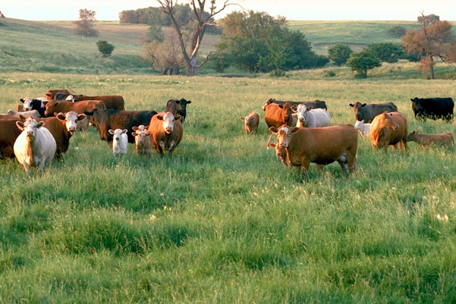
Beef Burger
Calves are raised with their mother on pasture or grass until they are 6-12 months old
Calves are weaned (no longer receive milk) and fed to a finishing weight (about 1,200 pounds) for slaughtering
Cattle can either be grain-finished or grass-finished
The meat is harvested and a 1,200 pound animal will produce about 500 pounds of boneless, trimmed meat including steaks, roasts, and ground beef
The rest of the animal is used for beef byproducts
Ground beef is typically produced and marketed with the beef and fat content—“80/20” ground beef is 80% beef and 20% fat, “90/10” ground beef is leaner and contains less fat
Most historians agree that humans began eating domesticated cattle in 6,500 B.C.

Slide 4
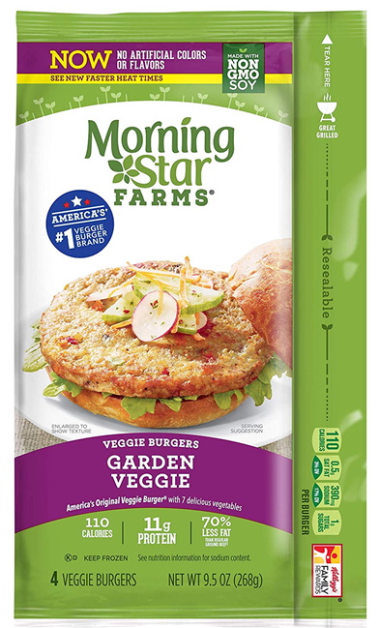
MorningStar Farms Veggie Burger
Plant-based protein
Ingredients include carrots, red bell peppers, corn oil, sugar, mushrooms, water, wheat, gluten, salt, soy, flour, onion, brown rice, water chestnuts, black olives, green peppers, dextrose, egg whites, whole grain oats, yeast extract
MorningStar Farms began producing plant-based meats in 1974

Slide 5
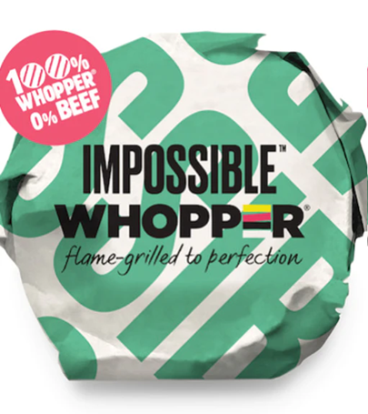
The Impossible Burger
Plant-based protein
Different from a veggie burger because it contains heme
Heme is an iron-containing molecule found in every living plant and animal—it looks and tastes like blood
The heme-containing protein from the roots of soy plants is used in the Impossible Burger
DNA from soy plants is inserted into a genetically engineered yeast
The yeast is fermented and multiplies, creating lots of heme
The heme is then mixed with other ingredients such as coconut oil, soy protein, textured wheat protein, potato protein, protein gel, xanthan gum, and gum gel
The heme is what causes the Impossible Burger to “bleed” like real beef
Impossible Foods was founded in 2011 and the Impossible Burger became available in 2019

Slide 6
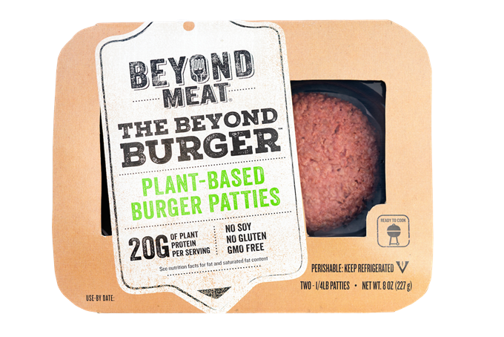
Beyond Meat
Plant-based protein
Does not contain heme or soy
The protein in Beyond Meat is a combination of pea, mung bean, and rice protein
Other ingredients include refined coconut oil, expeller-pressed canola oil, salt, apple extract, potato starch, water, vinegar
The red color—to resemble meat—comes from beets
Contains “marbling” that is made from coconut oil and cocoa butter
Beyond Meat was founded in 2009; the Beyond Meat burger debuted in 2016

Slide 7
 | Impossible Burger | Beyond Burger | MorningStar Farms Veggie Burger | 85% lean, 15% fat Beef Burger
Number of Ingredients | 21 | 18 | 37 | 1
Calories | 240 | 250 | 187 | 250
Fat (g) | 14 | 18 | 8 | 17
Saturated Fat (g) | 8 | 6 | 1 | 7
Carbohydrates (g) | 9 | 3 | 15 | 0
Sodium (mg) | 370 | 390 | 663 | 90
Protein (g) | 19 | 20 | 19 | 21
Cholesterol (mg) | 0 | 0 | <5 | 85
Based on a 4 oz serving size; burger patty only.²

